Slide 1
I will be with you shortly for the live presentation ☺
***Due to the time allotted for the meeting today I will not be able to monitor the chat and answer questions during the presentation.
IF you have questions specific to my class please email me :
rcsmith@cbsd.org

Slide 2
Welcome to 7th grade Science
Ms. Smith

Slide 3
Grade 7 Science is an integrated course that covers topics in the life, physical, and environmental sciences. The units of study include: Matter, Energy, Ecology, and Cells and Heredity.

Slide 4
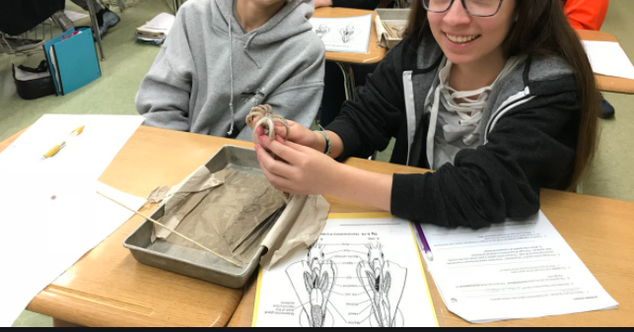
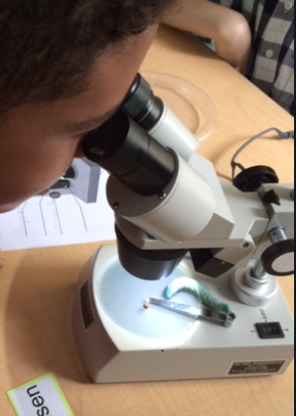
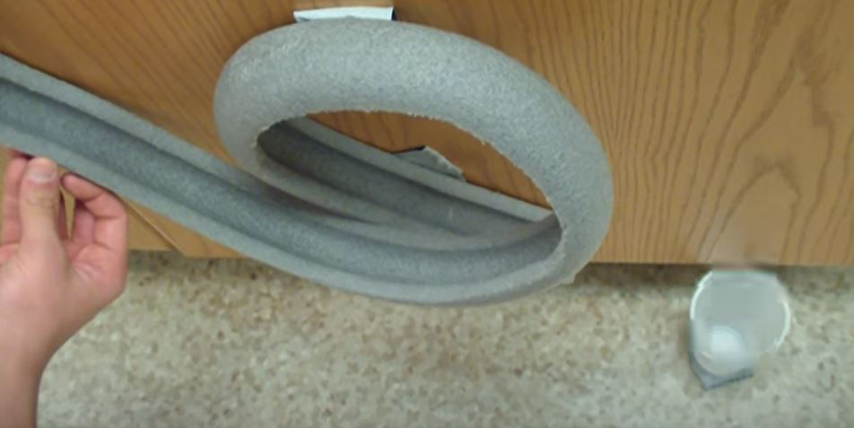
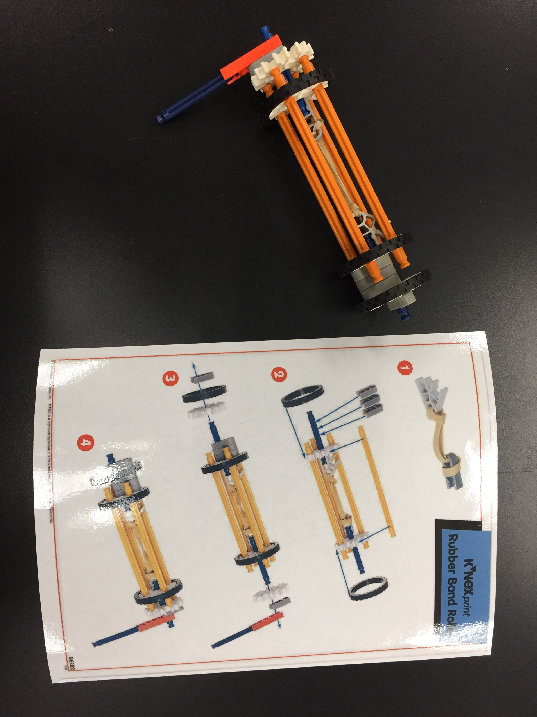
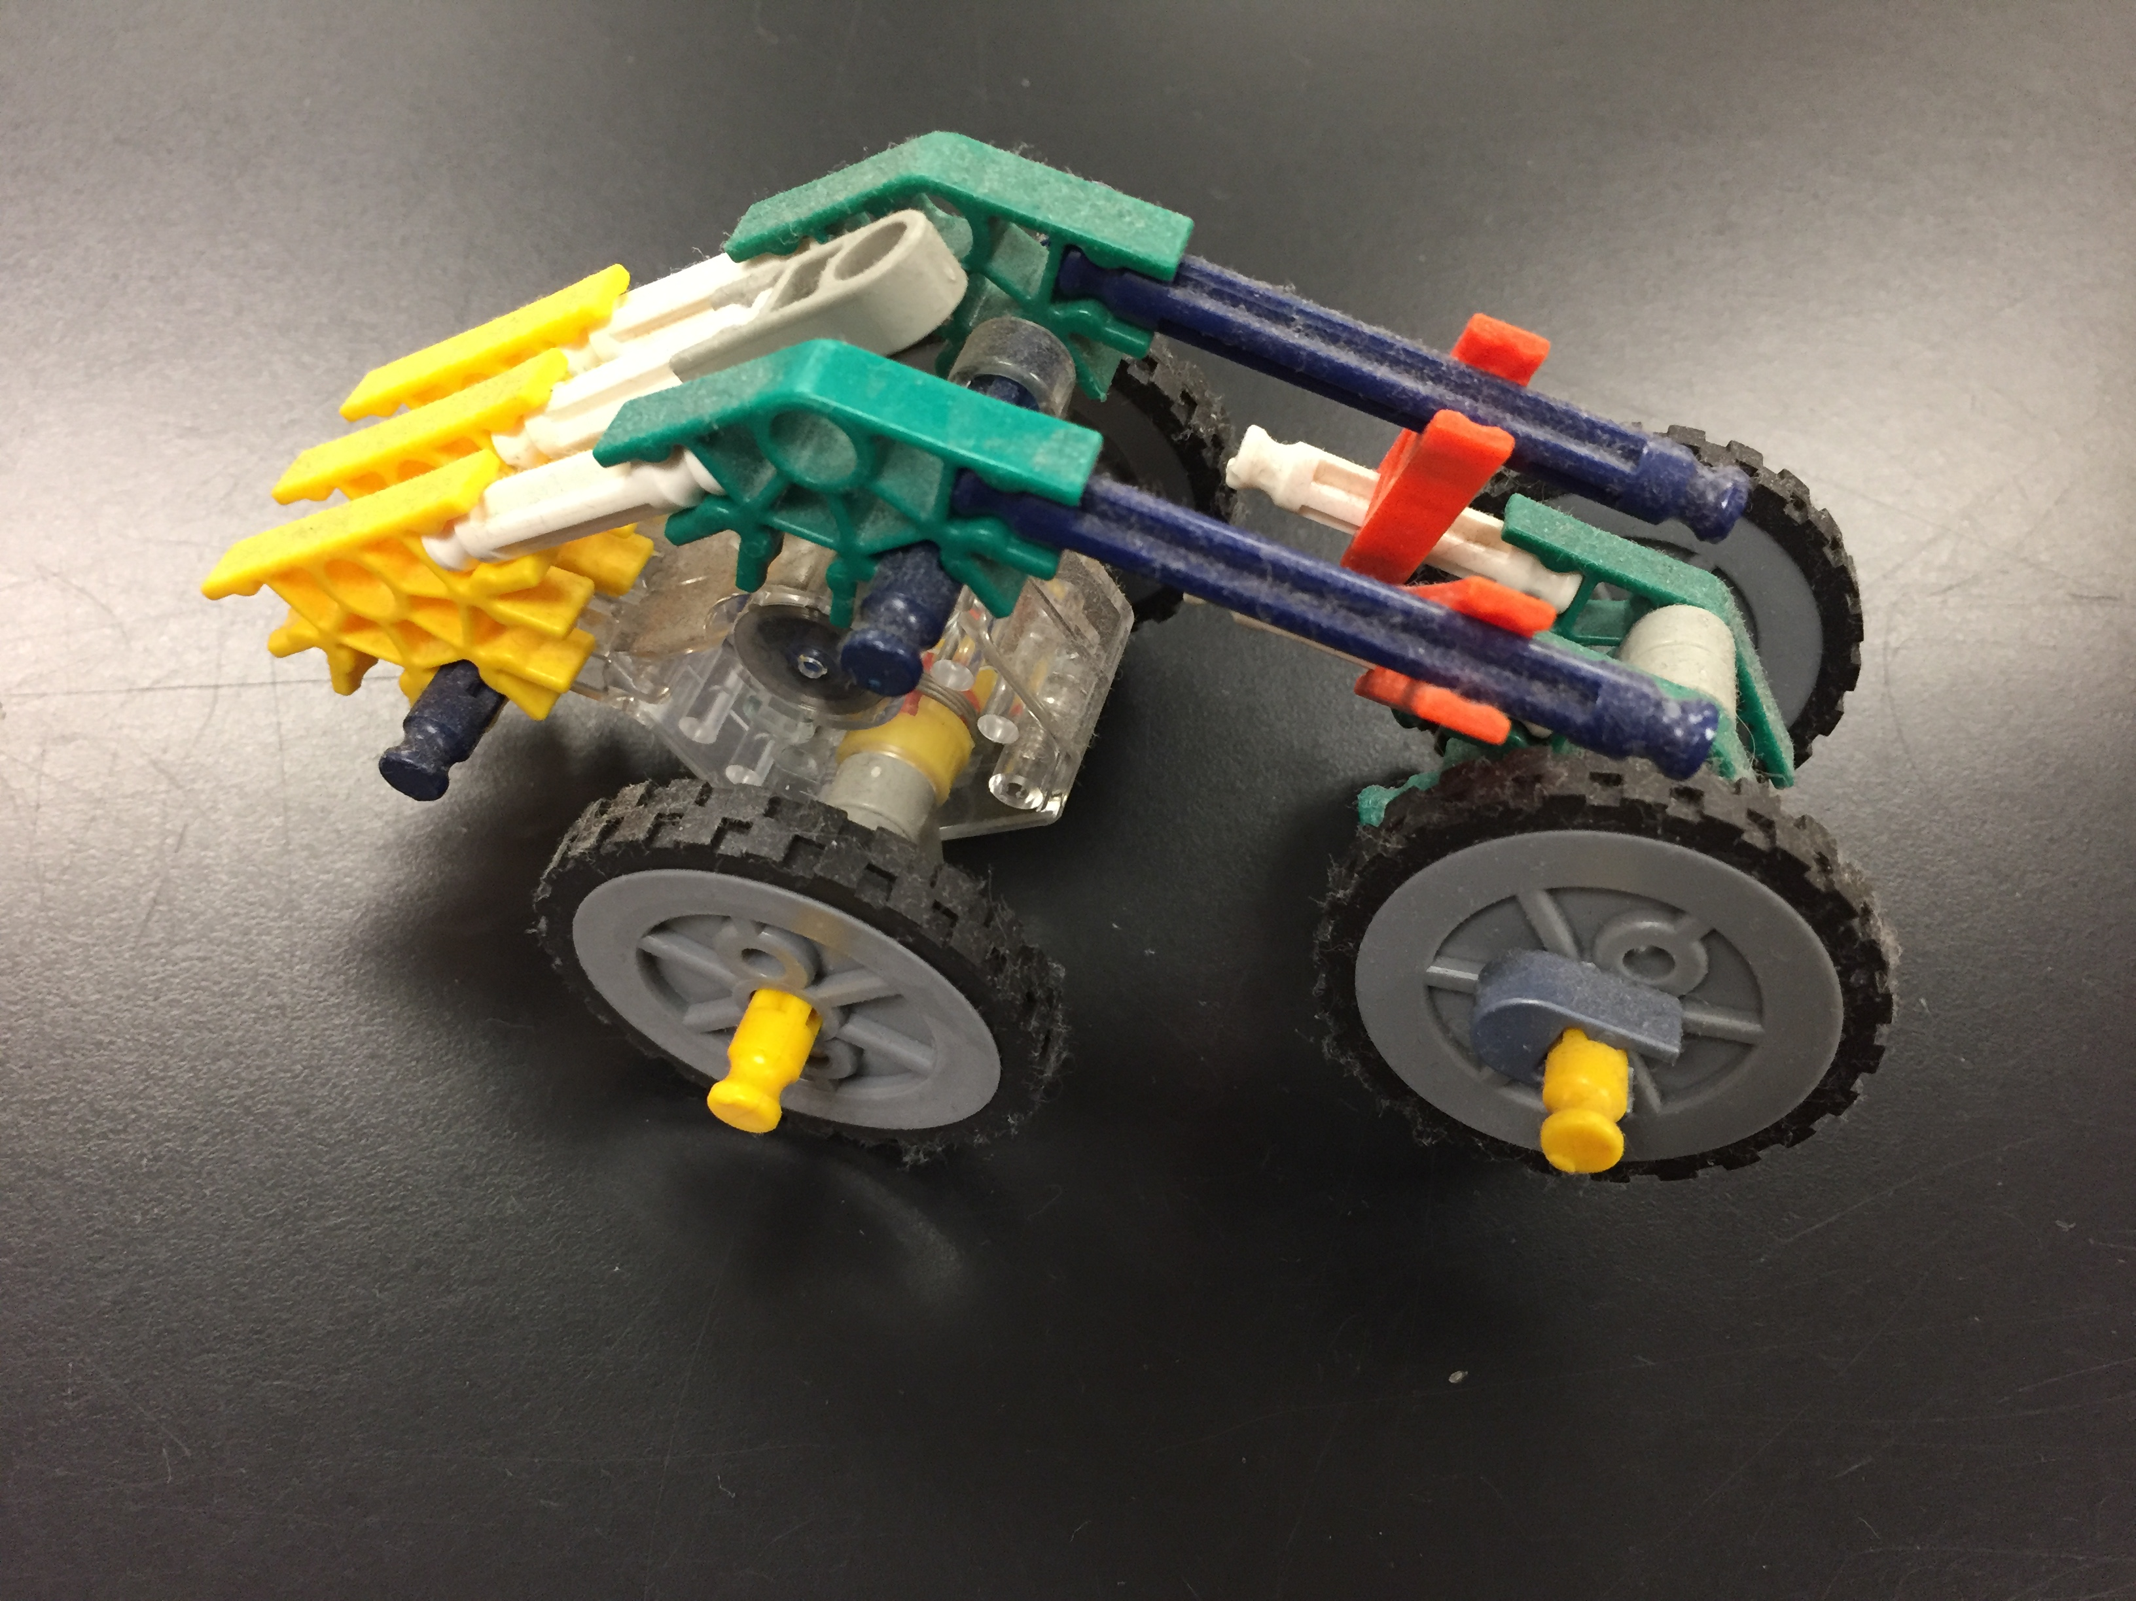
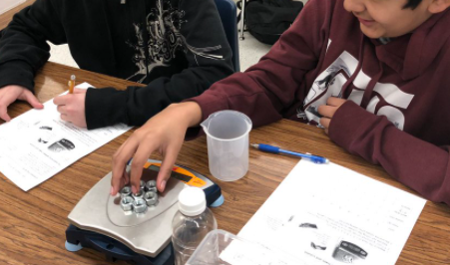
Labs

Slide 5
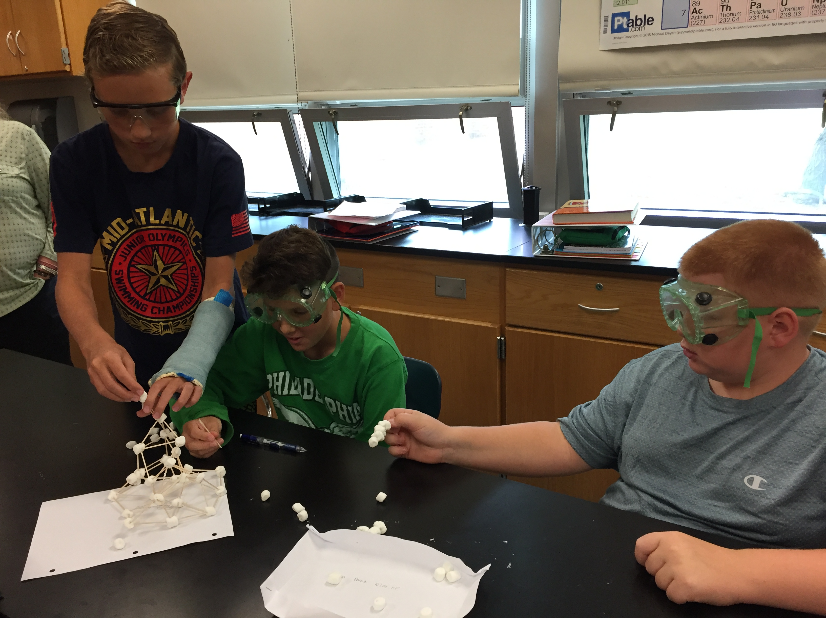
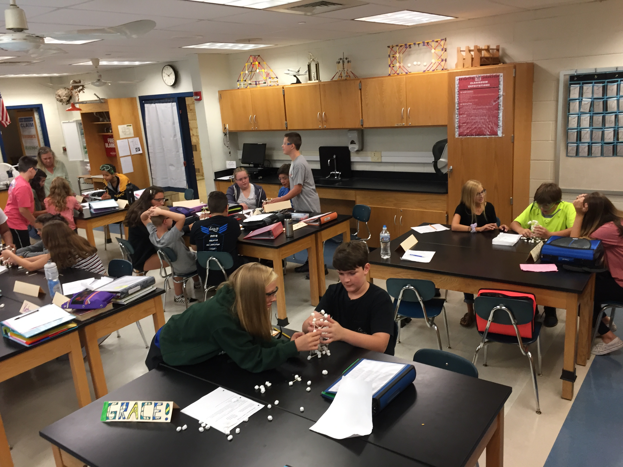
Class in Action

Slide 6
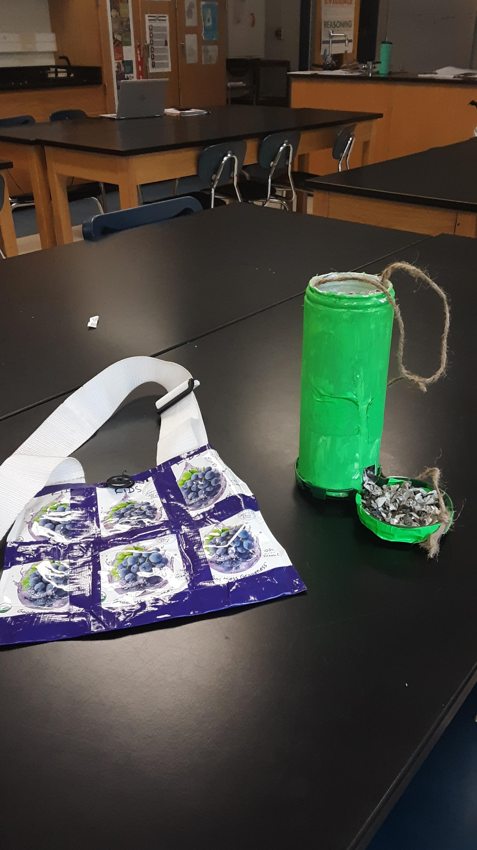
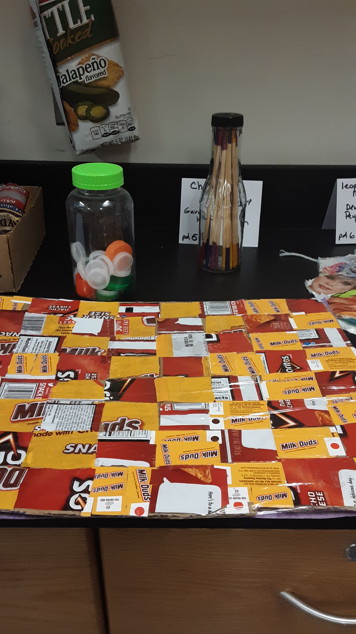
Upcycle project/ cookie lab
STEM
PROBLEM SOLVING

Slide 7
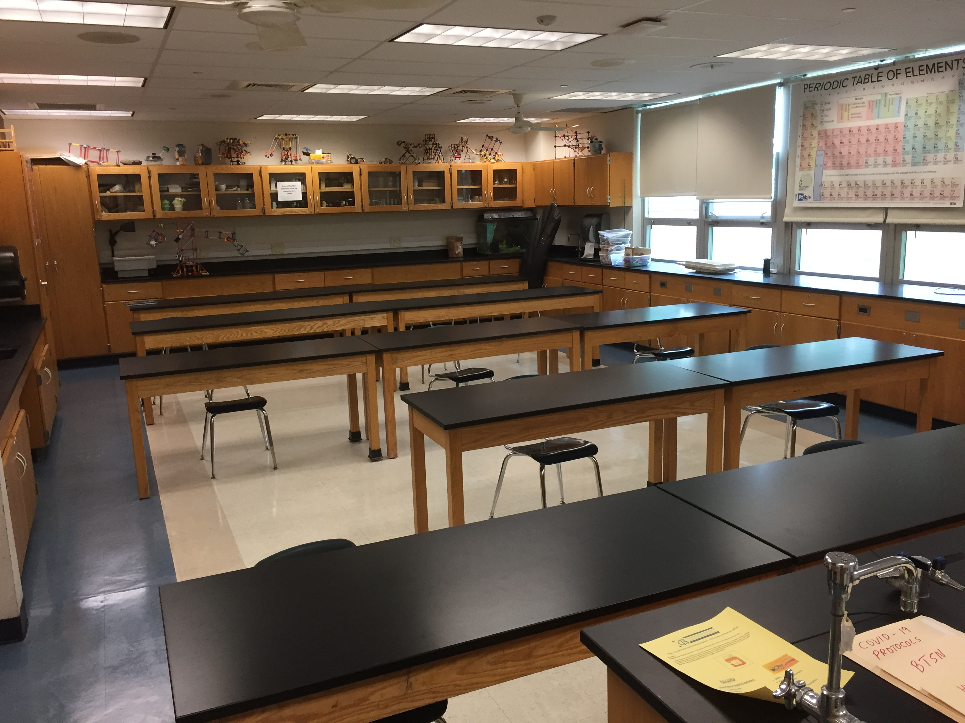
Classroom

Slide 8
CANVAS EXPECTATIONS
1. Start with Canvas every day. Click on your class.
Use the “Join Teams Call ” button on home page.
Click your class period for link to TEAMS.
Teams EXPECTATIONS
Live classes will take place during scheduled class time.
Sessions will be about 43 minutes long.
Sessions may be recorded.
Attendance will be taken.
Students are expected to follow appropriate behavior during live meetings.
Cameras On
Mute Your Mic
Sit in A Quiet Area
Participate
Be Prepared
Chat Responsibly
CLASSROOM EXPECTATIONS
1. Follow the rules the first time.
2. Respect your classmates and the teacher.
3. Raise your hand on Teams if you wish to speak.
4. Remember all school rules apply in our Virtual Classroom.
5. Make sure to check email and Canvas daily.
SYLLABUS
7th Grade Academic Science
rcsmith@cbsd.org
OFFICE HOURS
M / W / F 9:06 -9:36
Use the Office Hours Link in Canvas
Teacher Absence:
All assignments will be asynchronous.
Go to the Module in Canvas for that day.
Assignment will be posted on Canvas.
You must turn in your assignment for attendance.
Failure to turn in your assignment will mean you are absent from
class.
GRADING
Summative Grades will include:
Labs, Virtual Learning Projects, Group Work, Tests, Quizzes
Formative Grades will include all learning tasks.
Gradebook Abbreviations
M (Missing –work not completed yet)
ABSENT POLICY
Check Canvas!
All assignments will be posted.
You have as many days as you were absent to turn in the missing work.
SUPPLY LIST
None at this time.

Slide 9
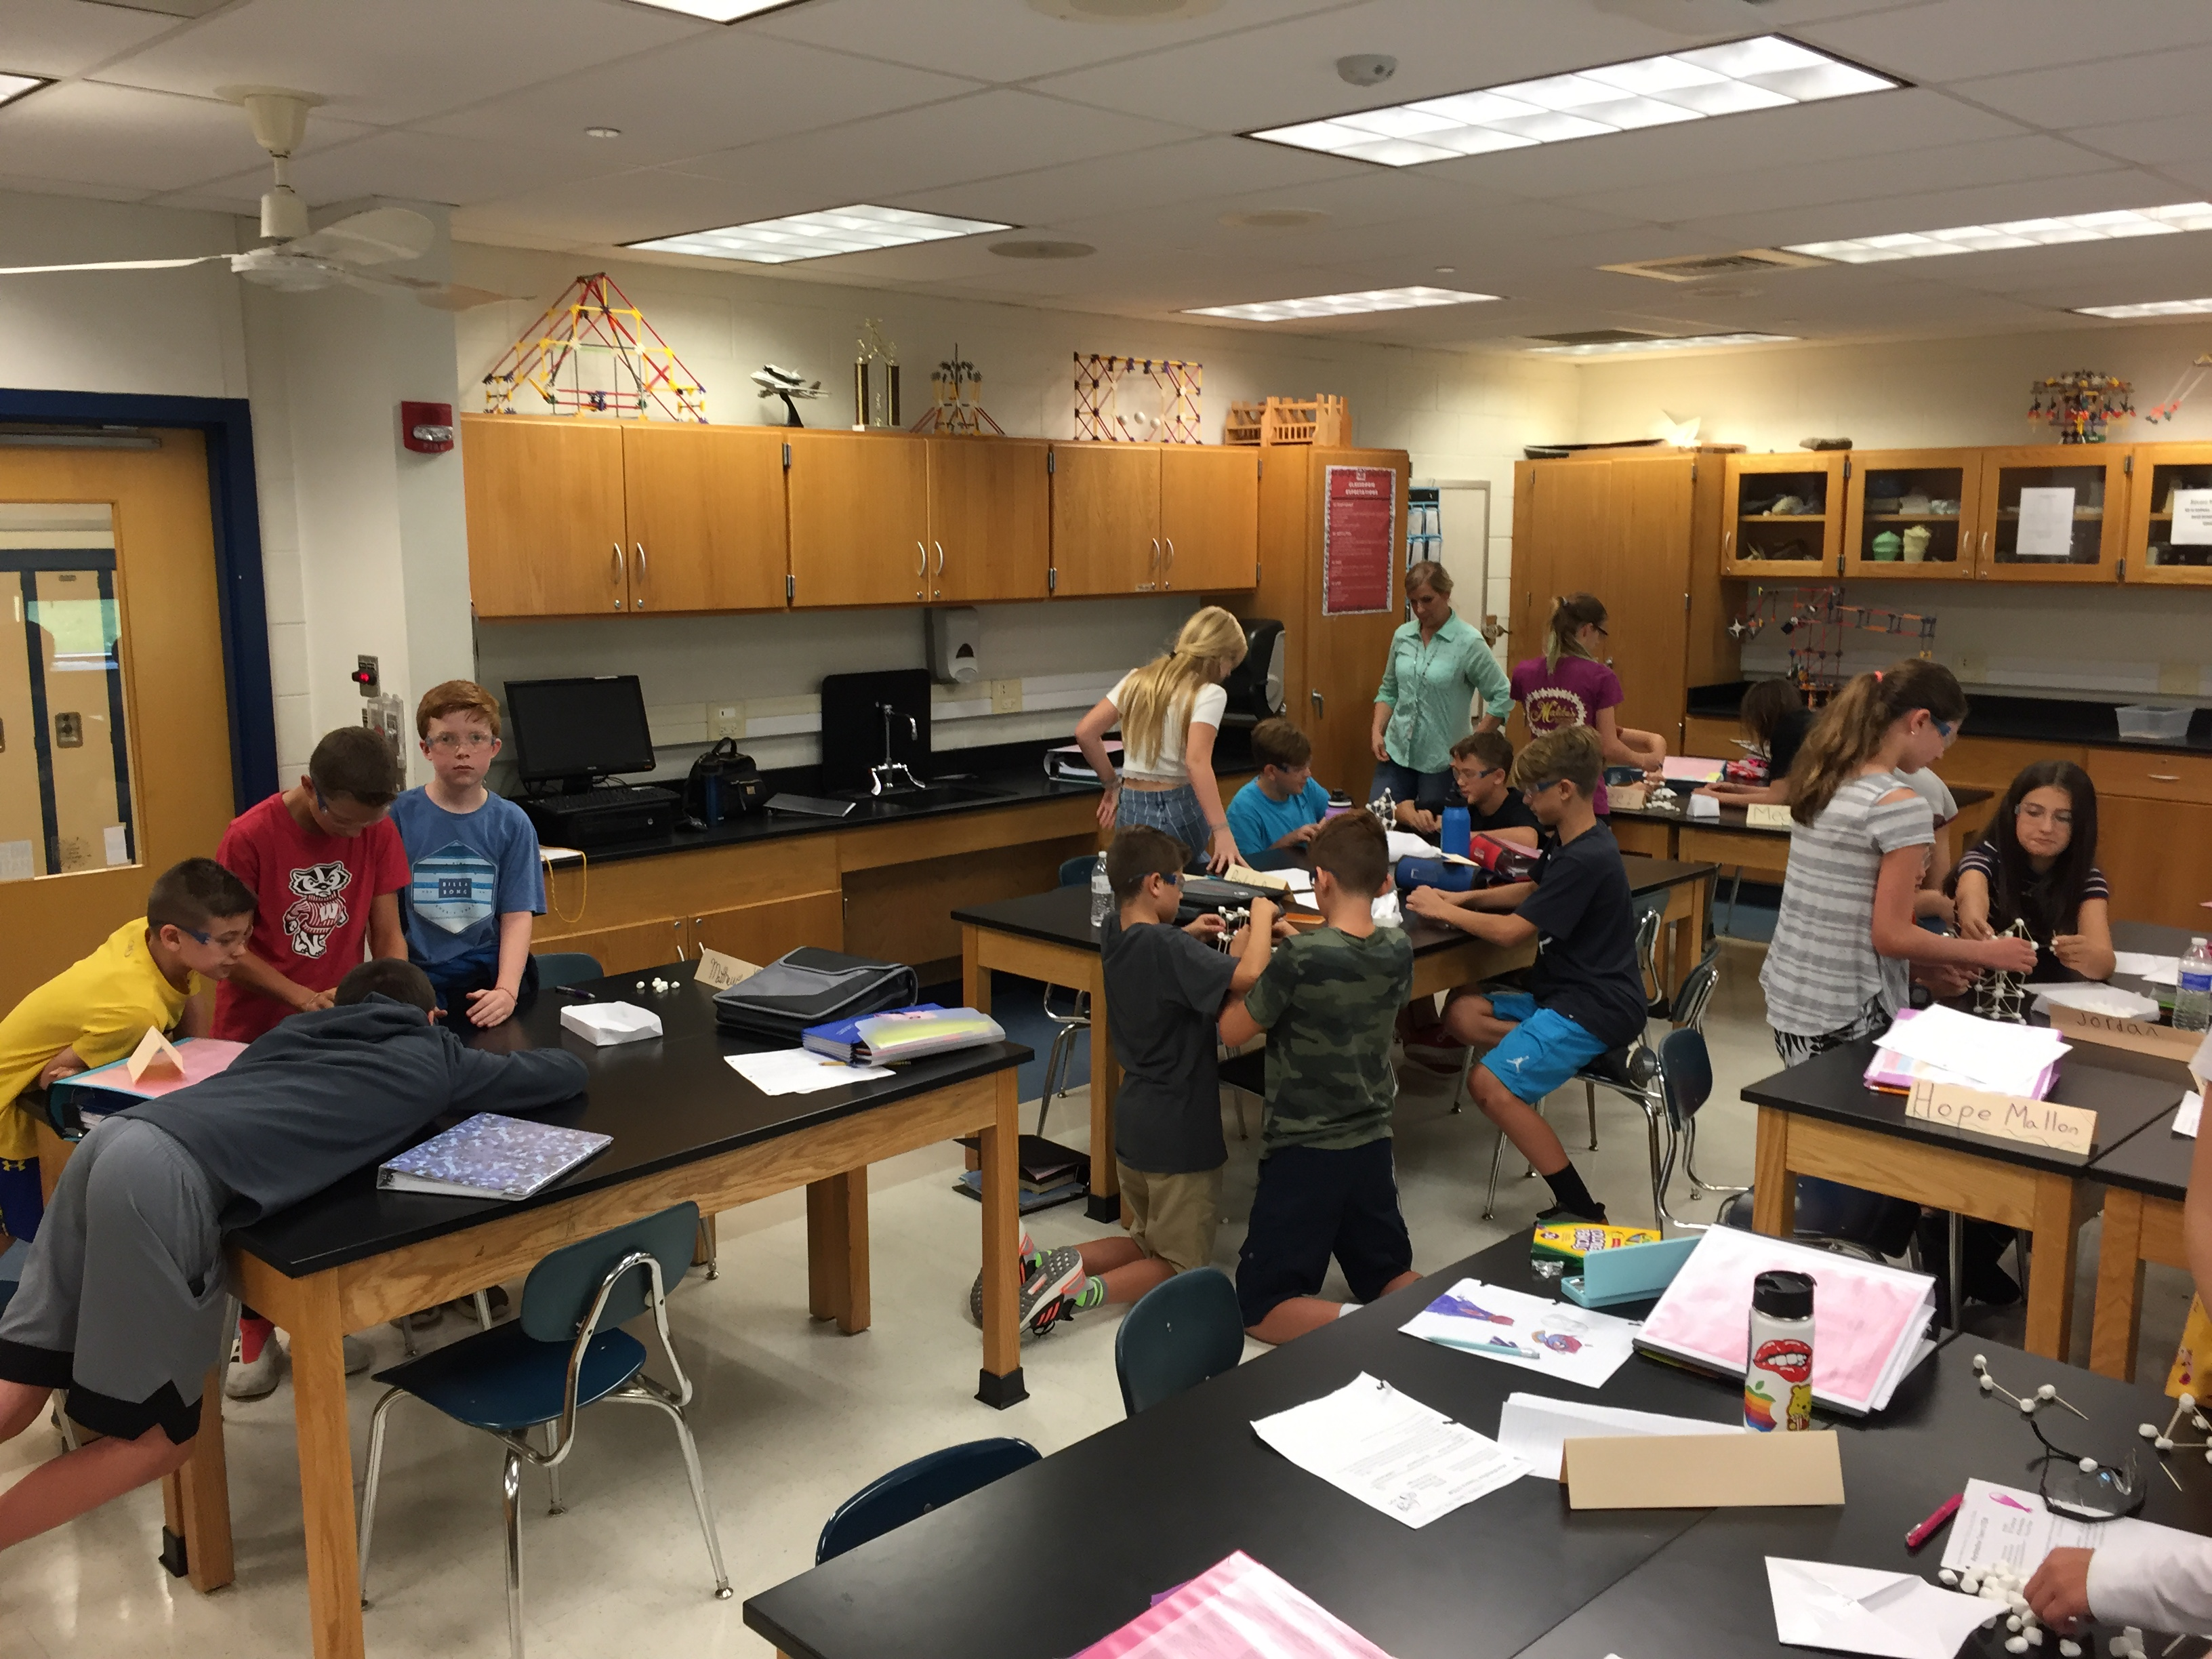
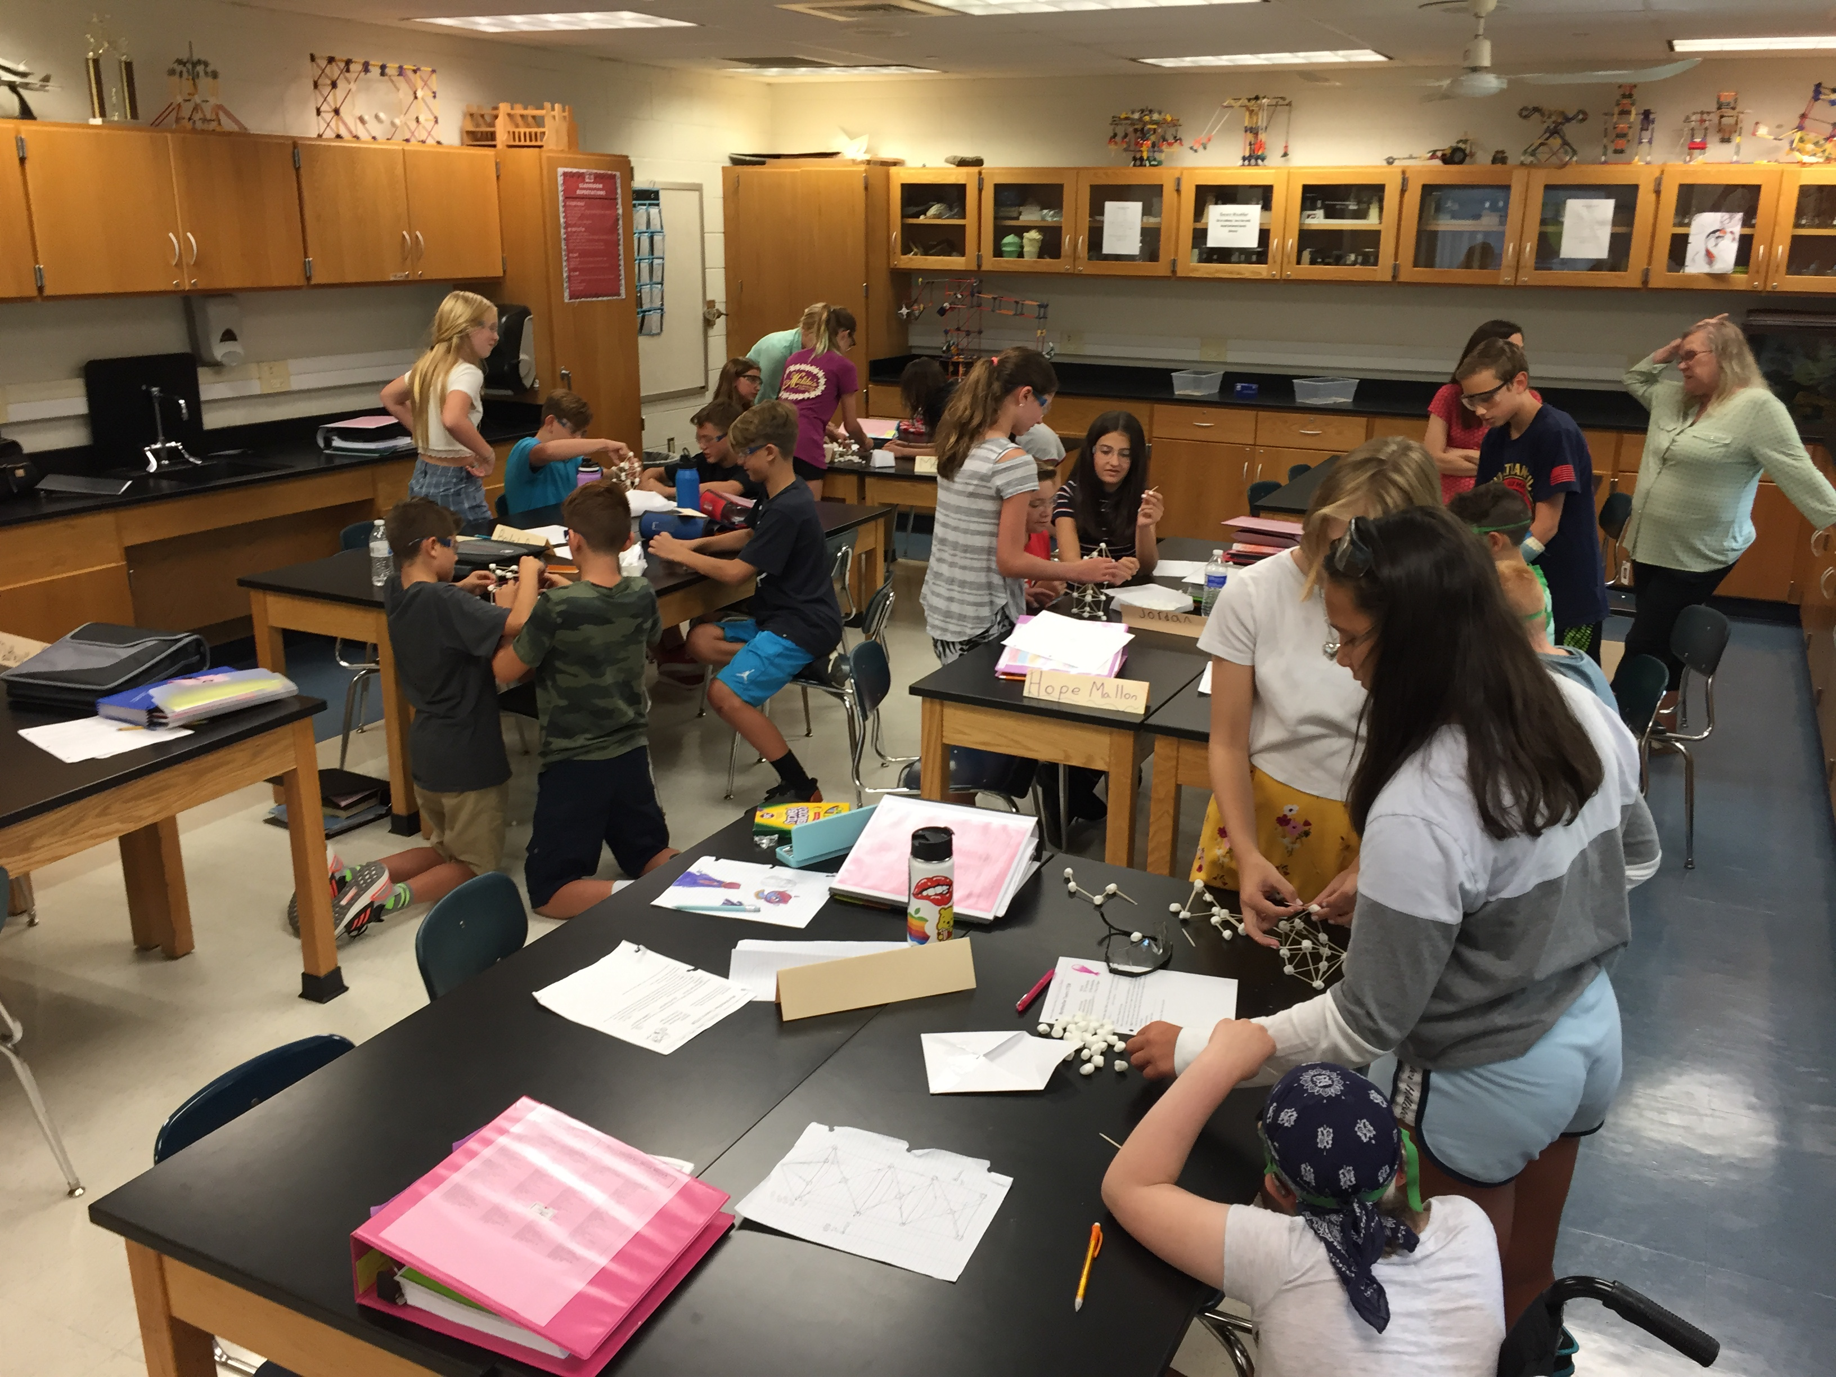
Labs when we return

Slide 10
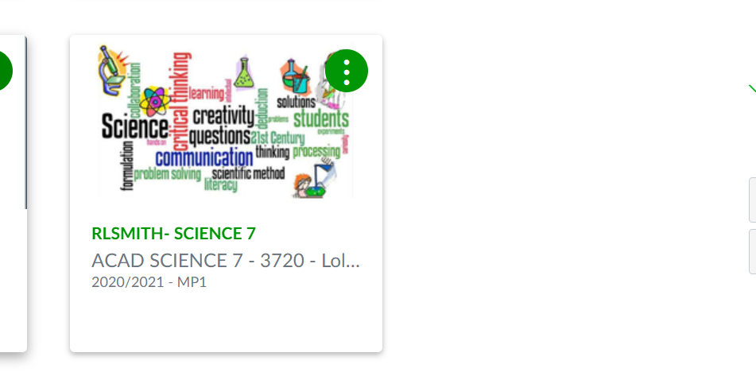
Canvas

Slide 11
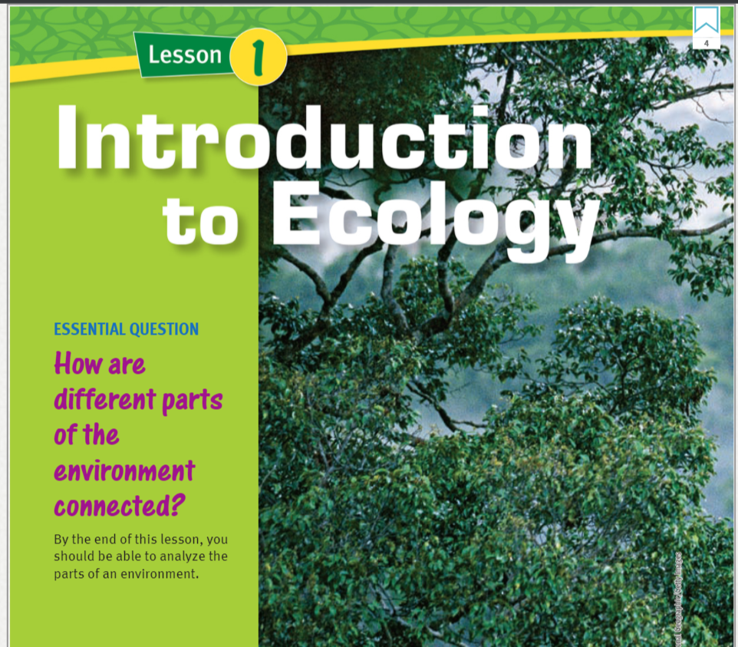
Online
Textbook

Slide 12
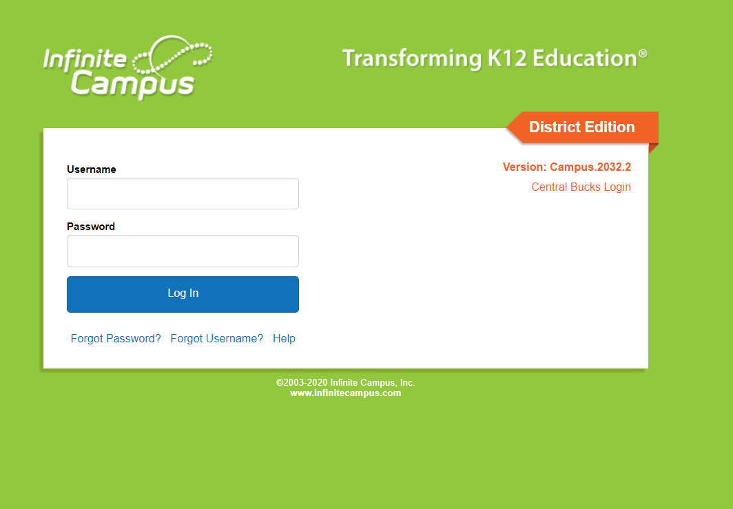
Grades

Slide 13
CITIZEN SCIENCE
Citizen Science allows individuals to directly contribute their own findings to large scale projects, and in turn, makes them more aware of the importance of science.
Open Tree Maps are collaborative, crowd-sourced projects where citizens help inventory urban trees, learn about the environmental benefits trees provide and explore nature

Slide 14
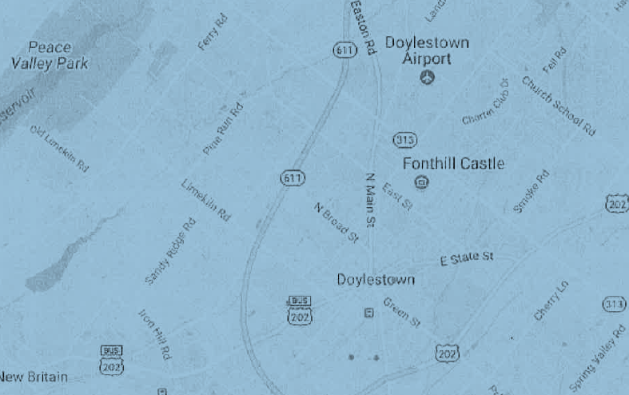
Tree Map

Slide 15
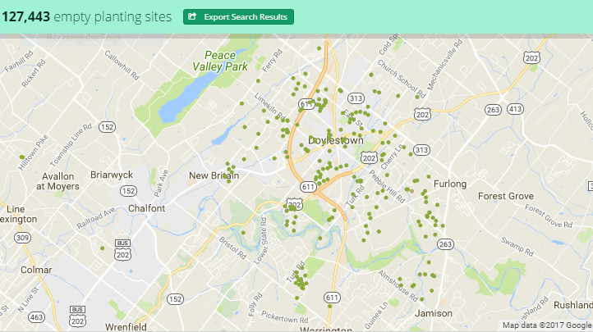

Slide 16
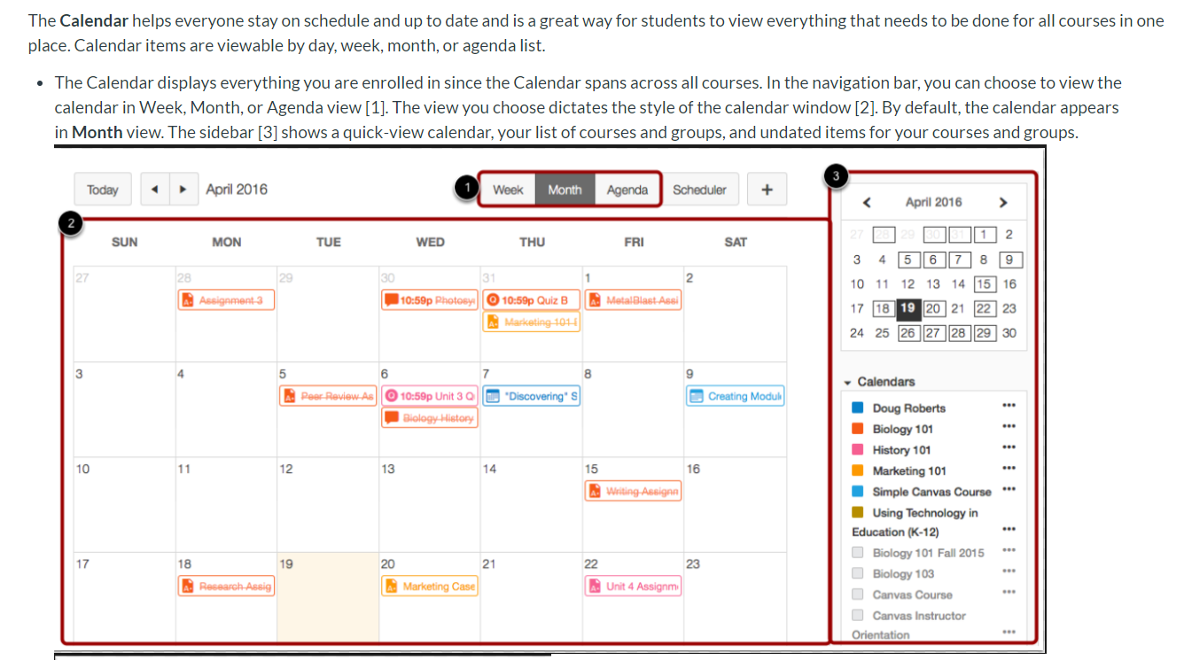
Homework

Slide 17
Final Exams
Test Dates: end of each marking period
Review Sessions: In class and online

Slide 18
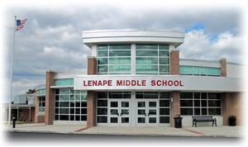
Contact
Info
If you have any questions, please email me at: rcsmith@cbsd.org

